Slide 1

Analysis on Used Cars
By: Ambrish Choudhary

Slide 2
Problem Statement
When shopping for a used vehicle, typically an overriding concern is: Am I paying too much? There is a need for a used car price prediction system to effectively determine the worthiness of the car using a variety of features.
It is important to know their actual market value while buying.
People keep one car for home use so instead of buying new car people prefer used car. Also, many people prefer to buy used car as their first car while learning driving.

Slide 3
Data Analysis & Observations
The year in which the car was sold were range from 1953 to 2016.
The data set contains 87 distinct car values.
There are 267 rows with the price as zero.
There were some cars sold with mileage of zero indicating that the dealership sells new vehicles along with old ones. Also the outliers >900 are only 5 in number also there are other value surrounding it which inclines us more to think that these could not be outliers.
There are 434 null values in this engV which could be replaced with the median of the data.
The fuel type consumed by the engine have only 4 distinct values petrol, gas, diesel and other.
The model name has very high cardinality (888 unique values).
Only 4 possible values for drive type of the vehicle. There are 511 missing values and could be replaced with the mode of the data as this is categorical data.

Slide 4
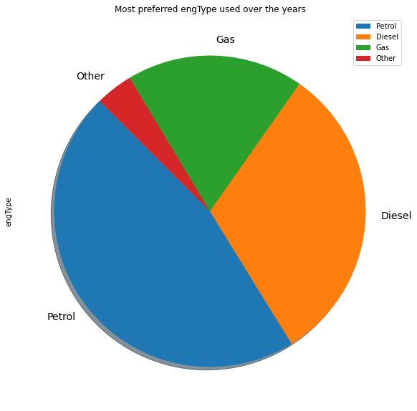
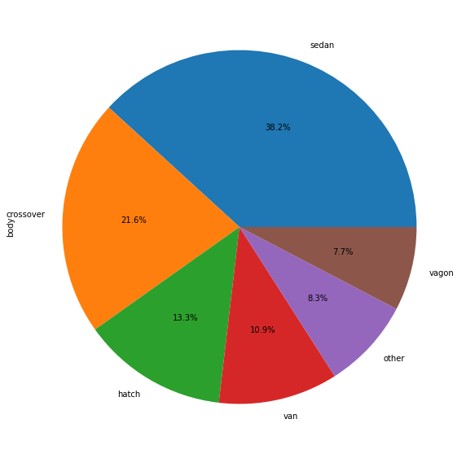
Sales Distribution - Engine Type & Body Type
This shows Petrol is the most preferred car.
Sedan(38.2%) is the highest sold body type followed by crossover(21.6%) and hatch(13.3%)

Slide 5
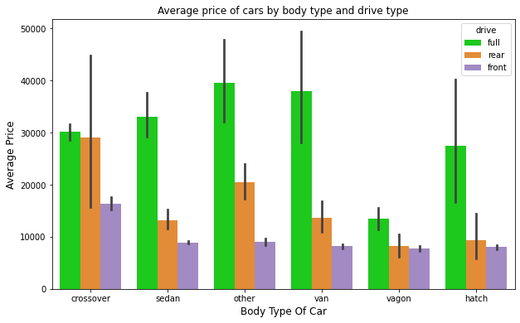
Average Price – Body Type and Drive Mode
All body types of cars have more average price for full drive type cars compare to other drive types.

Slide 6
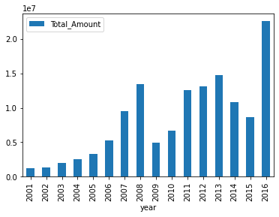
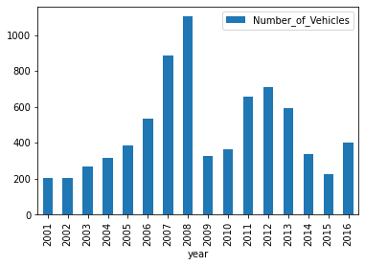
Number of cars sold and the total value of cars by year
The max number of cars sold was in 2008
The max number of cars sold by the total value was in 2016

Slide 7
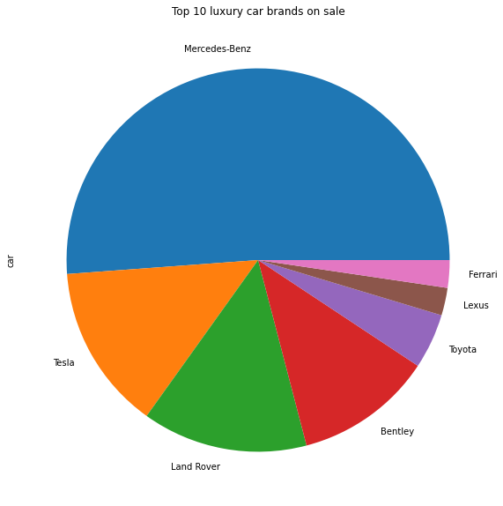
Luxury Cars Analysis
More than half of the luxury cars (price > 150000) Mercedes–Benz followed by Land Rover and Tesla

Slide 8
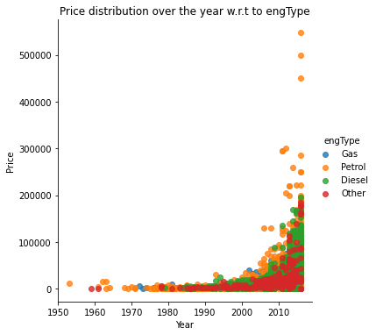
Price distribution by the years w.r.t. engType
As the years increase, there is significant increase in prices of cars models having engine type = "Petrol" as compared to "Gas" and "Diesel".
Majority of the cars with production year 2008 or later sold in price 50000 or lower.
All the cars with production year 2010 or later sold in price more than 50000.
All the cars with production year before 2010 sold in price 50000 or lower.

Slide 9
Conclusion
Petrol powered cars are sold the maximum.
Mercedes-Benz still remains the epitome of luxury with every 1 of 2 luxury cars being sold a Mercedes.
We observe that out of total cars sold, majority of the cars sold by "Volkswagen", "Mercedes-Benz" and "BMW" brand.
"Sedan", "Crossover" and "Hetch" body types cars are the highest sold cars.
"Front" wheel drive cars are th top most cars in all body type except in "Crossover" body type. In "Crossover" body type "Full" wheel drive cars are leading.
80% of total cars sold in the price range of 200 to 20000 with body type as "Sedan", drive type as "Front" and engine type as "Petrol", because the middle class families preferred low price cars with Sedan body and Petrol engine type.
Majority of the higher price range cars sold with body type as "Crossover", drive type as "Full" and engine type as "Diesel".
All body segment and engine type of cars have more average price for "Full" drive type cars compare to other drive type cars.
Production year 2008 cars are the highest sold cars.

Slide 10
Actionable Insights
Top 5 highest price selling car and their models information can be used for email marketing for high profile income group peoples to achieve sales goals.
Similarily top 5 lowest price selling car and their models details can be used for email marketing for low to middle profile income group peoples to achieve sales goals.
Max sale was done in the Year 2008. This info can be use to start working/research why sale was max in this year. What was the factors affected this sale/registrations.
Price varying based on Year and Mileage - as Year increases there is increase in Petrol engine type vehicles's prices which also depending on mileage too.
Companies can keep inventory of cars with body type as "Crossover", drive type as "Full" and engine type as “Petrol".
Used car market is quite big and growing year on year basis, and Middle class families could be the main target customers.
People prefere to buy registred cars so companies can avoid selling unregistered cars.

Slide 11
Thank You!

